Slide 1
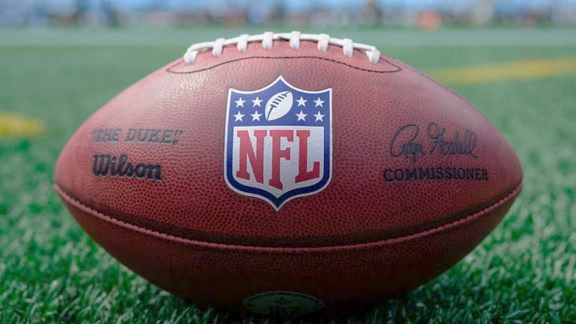

Broncos Extra Point NFL Stats
Presented by: Rob, Aarthi, Diego, Prabu
Notes:
Prabu
Introduction to us.....
Welcome to the Broncos Extra Point, where Bronco members(Rob, Aarthi, Diego, and I) of the NFL's football data and analytics team will share updates on Nationwide trends in football data. These interesting visualizations showcase innovative ways to use the league's data and provide an inside look at how the NFL uses data-driven insight to improve and monitor player and performance.
Background music
https://www.youtube.com/watch?v=KxNGMvNIvP8

Slide 2
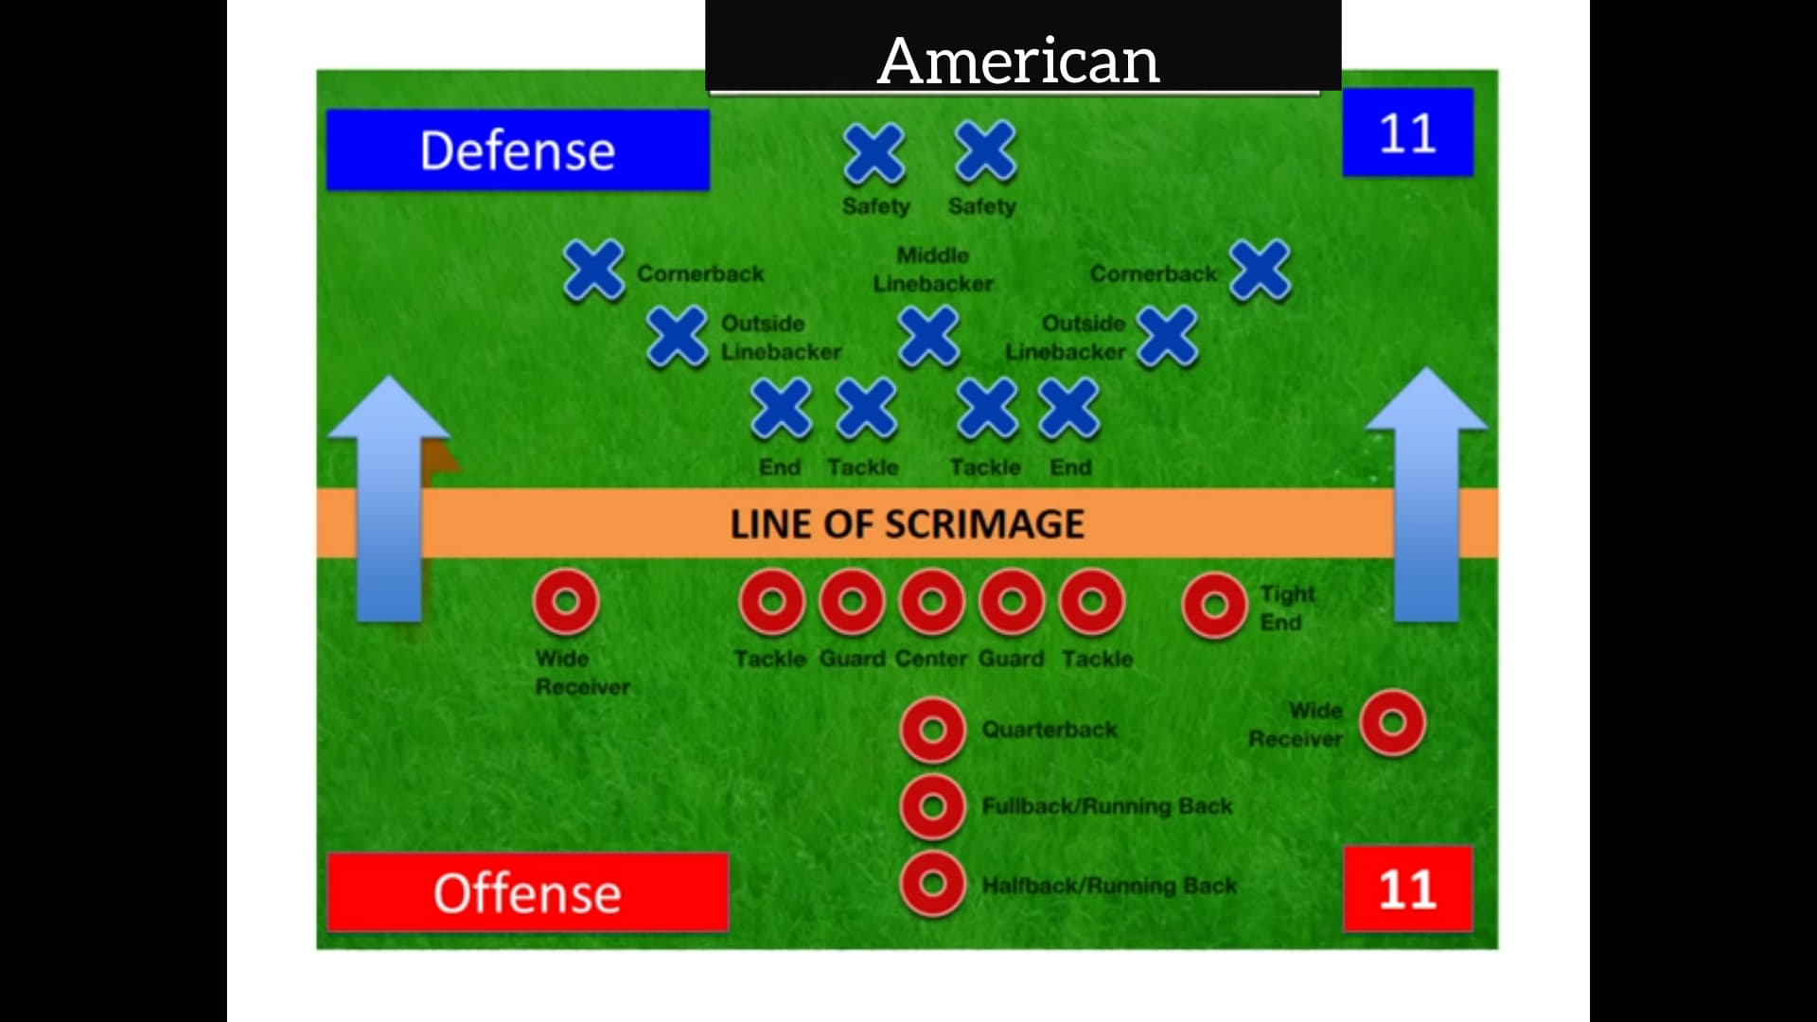
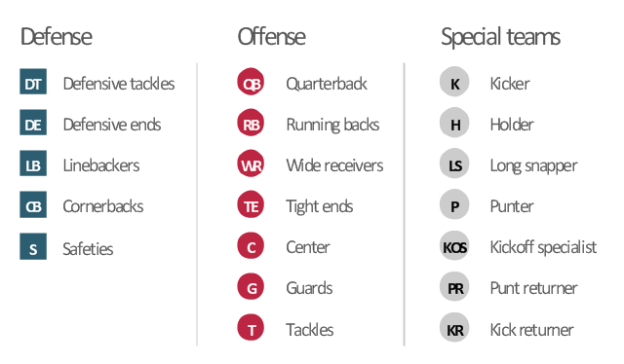
Notes:
Rob
One of the first challenges we faced was understanding what the data meant. In order to do so, we had to understand the game of football.
Challenges we’ve had with understanding the data -knowing football positions (How each position was rated)
Football positions diagram: https://en.m.wikipedia.org/wiki/File:American_Offensive_and_Defensive_Positions.jpg
Image: https://www.conceptdraw.com/examples/number-symbol-for-football-player

Slide 3
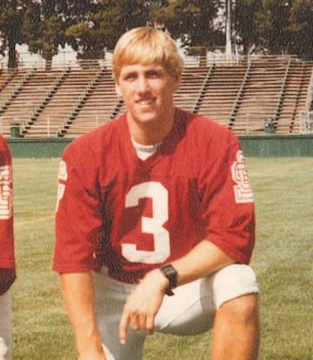
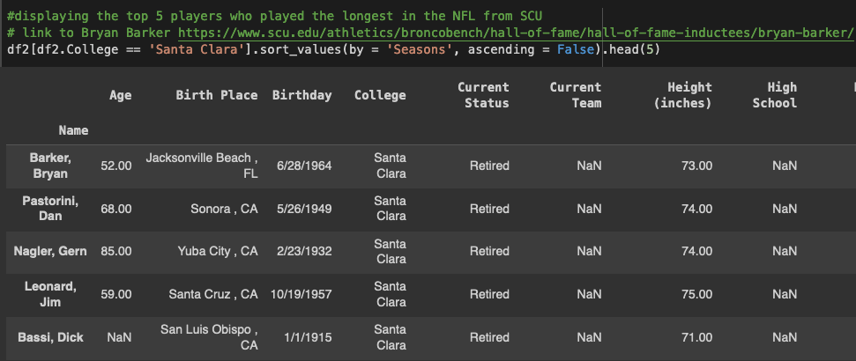

Football at Santa Clara University
University of Santa Clara (later Santa Clara University) had a football team from 1902-1991
384 wins, 248 losses
Last Coach of SCU: Terry Malley
Produced 20 NFL athletes
Brian Barker ‘86 is a Bronco Hall of Famer
Notes:
Rob
One interesting Finding
https://www.santaclarabroncos.com/fanZone/sportsHistory/SCU_FB_History.pdf
Sport: Football
Years Attended: 1982-1986
3x NFL Mackey Award Recipient
1997 Pro-Bowl
Inducted in 2018
Barker, a punter for the Broncos, went on to an illustrious professional football career. After graduating from Santa Clara as the all-time leader in punts, Barker played 16 years in the NFL with the Kansas City Chiefs, Philadelphia Eagles, Jacksonville Jaguars, Washington Redskins, Green Bay Packers, and St. Louis Rams. In the NFL, Barker was an All-Pro selection and Pro Bowler in 1997. He won the NFL Mackey Award three times, as the best punter in his conference. Barker’s streak of 878 consecutive punts, without a block, ranks second in NFL history.

Slide 4
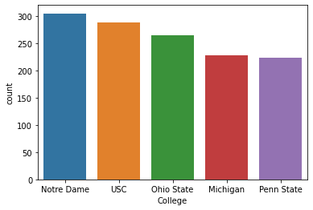
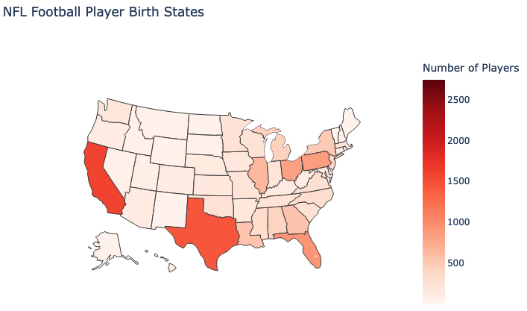
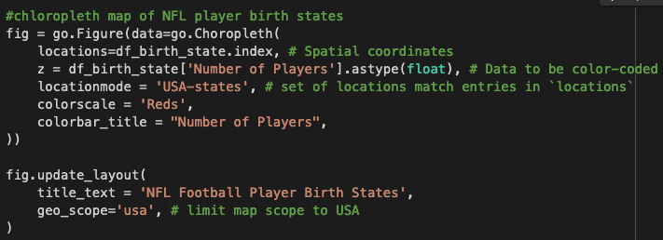
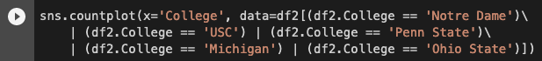
Where do NFL Players Come From?
Top 5 NFL Producing Colleges
Heat Map of NFL Player Birth Places
Notes:
Rob

Slide 5
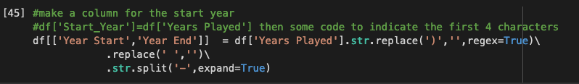
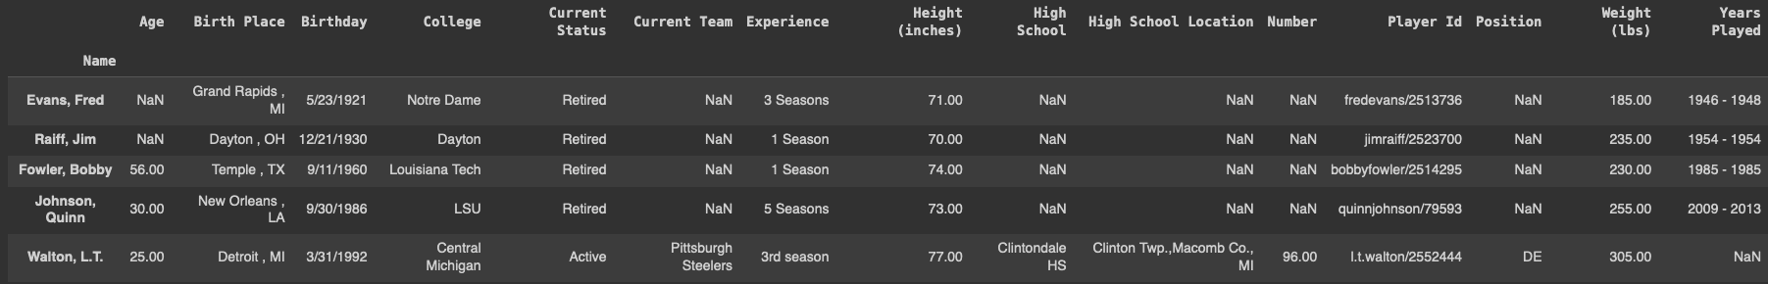
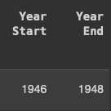
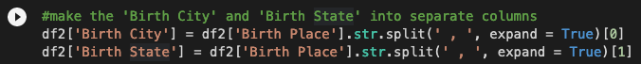

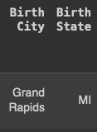
Basic NFL Stats Exploration
Data Cleaning seasons column
Data: df: Basic_Stats.csv
Columns, Rows = 17026, 17
Rows: name, age, birthday, college, Player Id, etc.
Missing values: 87597
Timespan: 1926-2017
Packages used: Pandas
Source: Kaggle
Notes:
Rob

Slide 6
Insights perceived
Basic NFL Stats Exploration
Football at SCU
Data Visualization
Top 5 colleges that produce the most NFL athletes
NFL Statistics over the years
Heat map for where players come from using plotly express
Machine Learning - Classification tree to predict if a QB will continue playing or not
Notes:
Rob

Slide 7
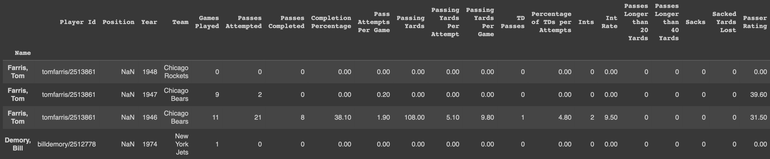
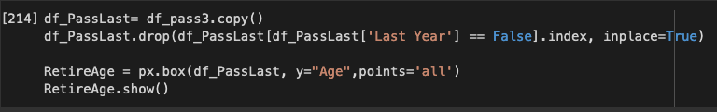
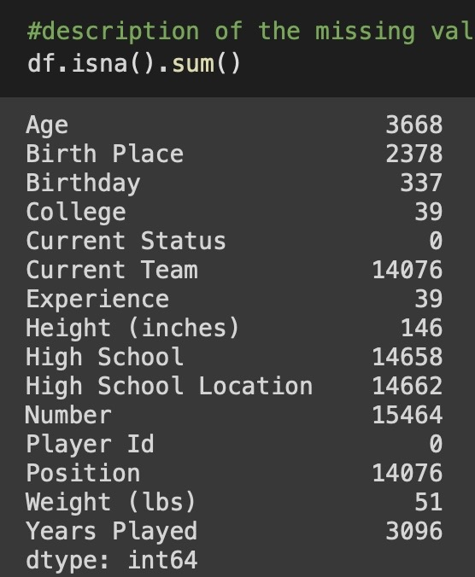
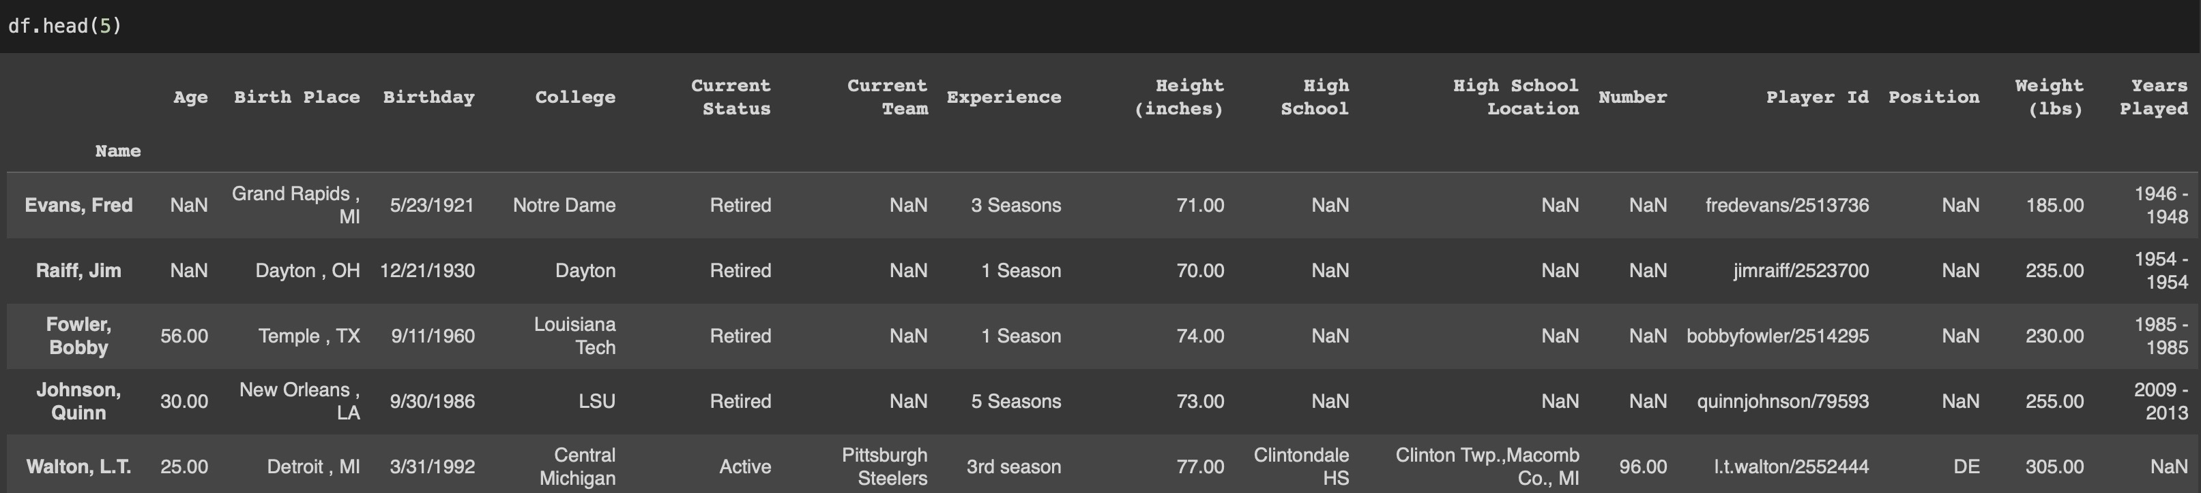
Data Janitoring
Notes:
Diego
Data Janitoring
Filled year end nan values with the year 2017
Determine what is the last year for each player by looking at the highest year played.
Converting the data type of ‘Year End’ from string to integer.
Dropped all missing values from experience column.
Cleaned the Experience column - removed the strings such as ‘nd’ ‘th’ ‘rd’ ‘st’ ‘season’ ‘seasons’ ‘Season’ ‘Seasons’ and replaced ‘Rookie’ with ‘1’
Created a new column ‘Seasons’ from the cleaned experience column
Converting the data type of ‘seasons’ from string to integer
Created many data frames for each of our analysis to ensure no data was dropped for each of the categories we were doing.
We had two data frames, one for all players including retired. Unfortunately this didn’t include position.
Age
Height
Weight
Years played
Passing statistical analysis
Data merging needed for our machine learning portion

Slide 8
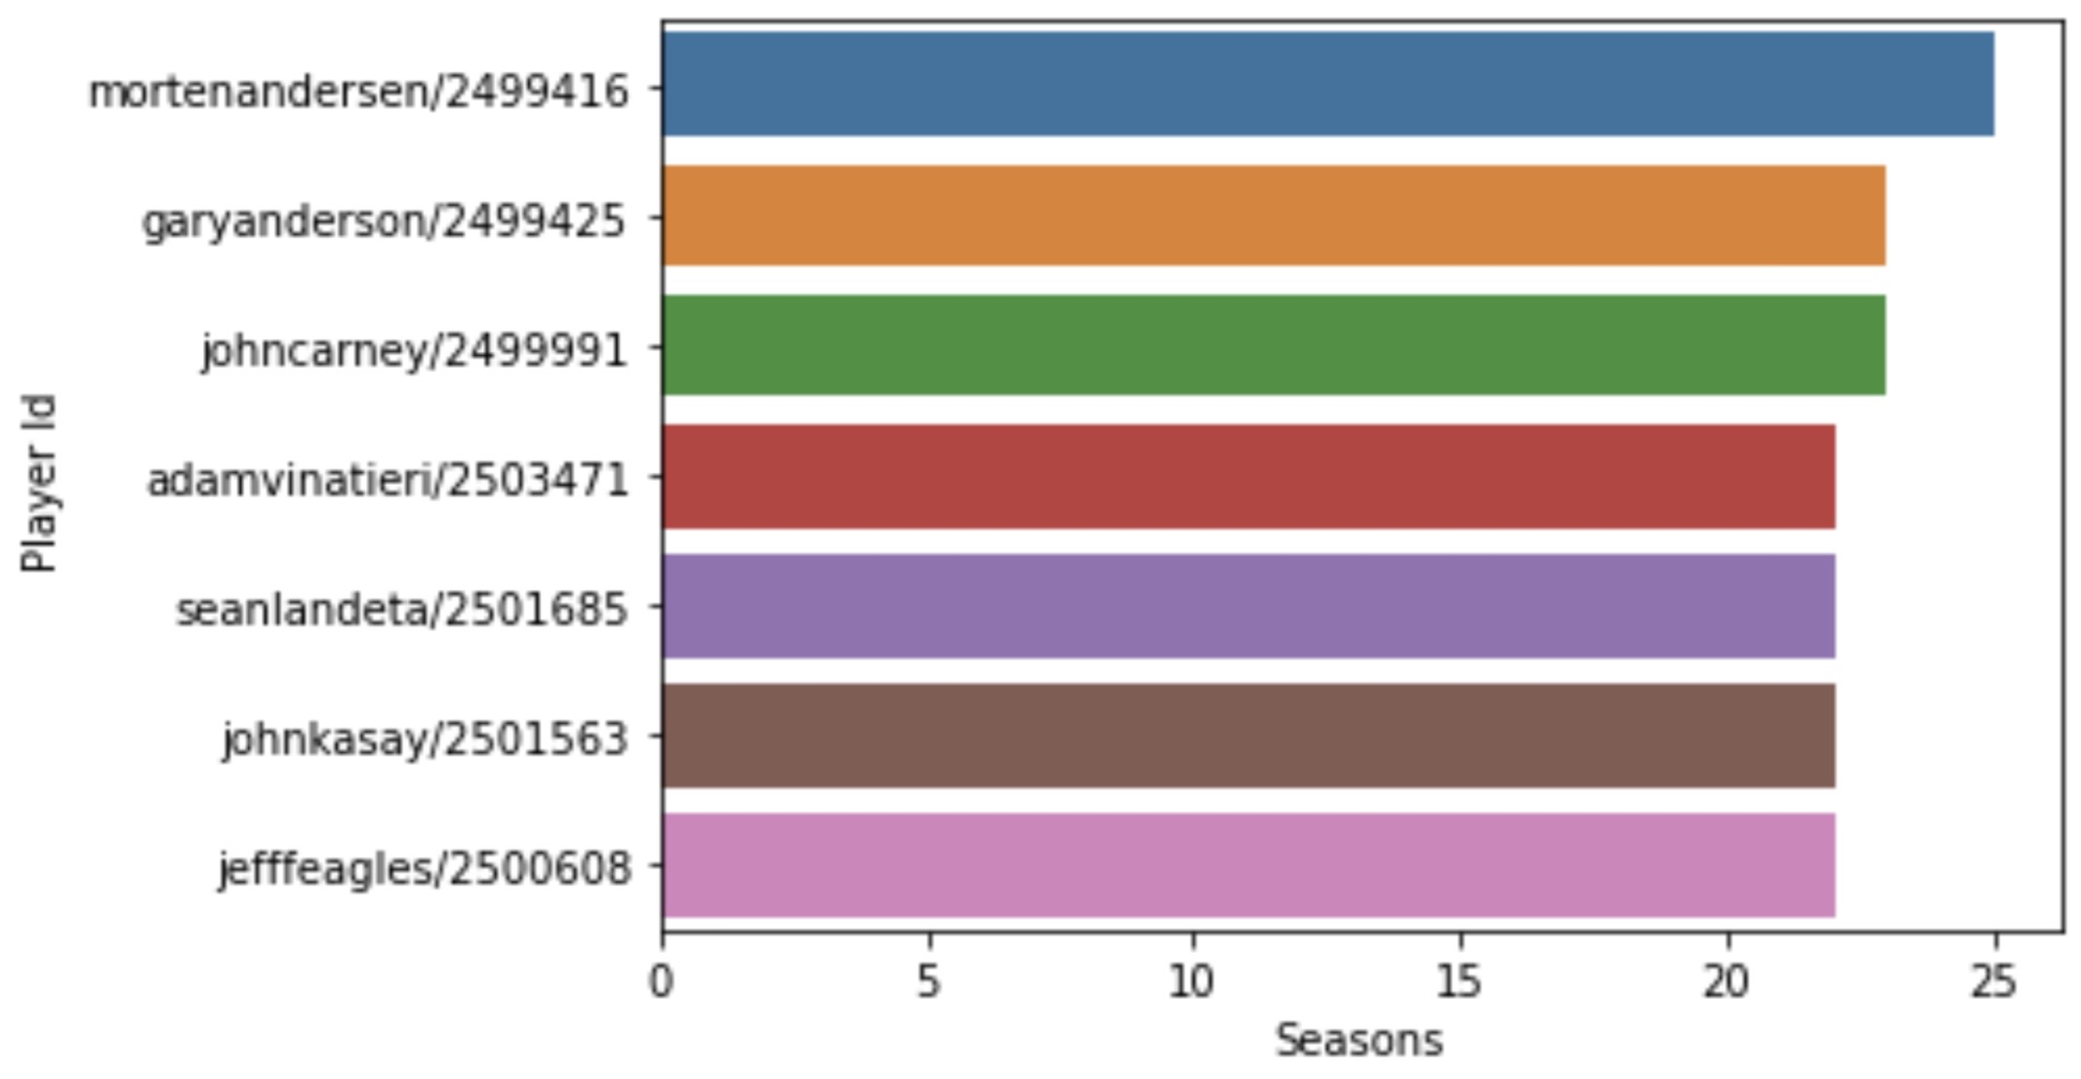
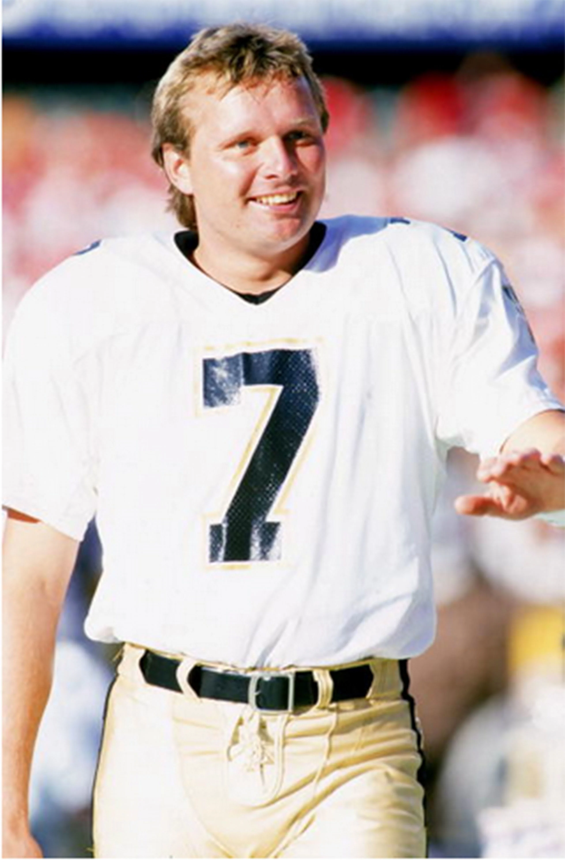
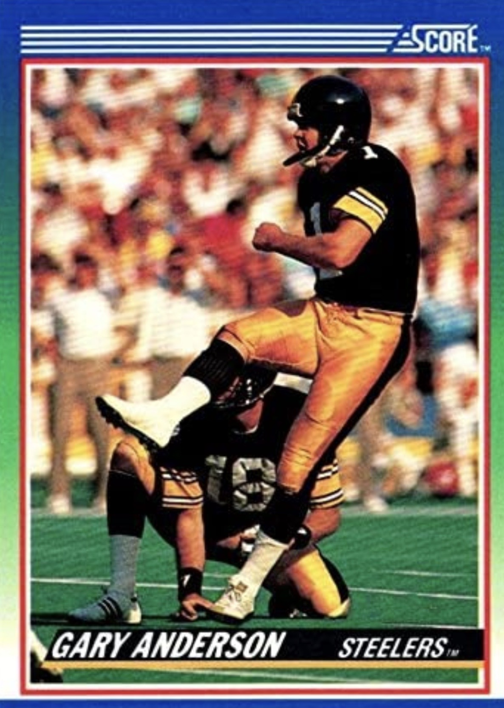
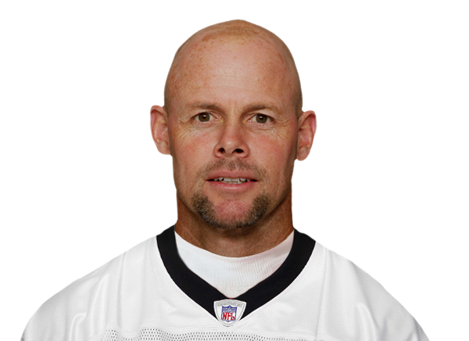
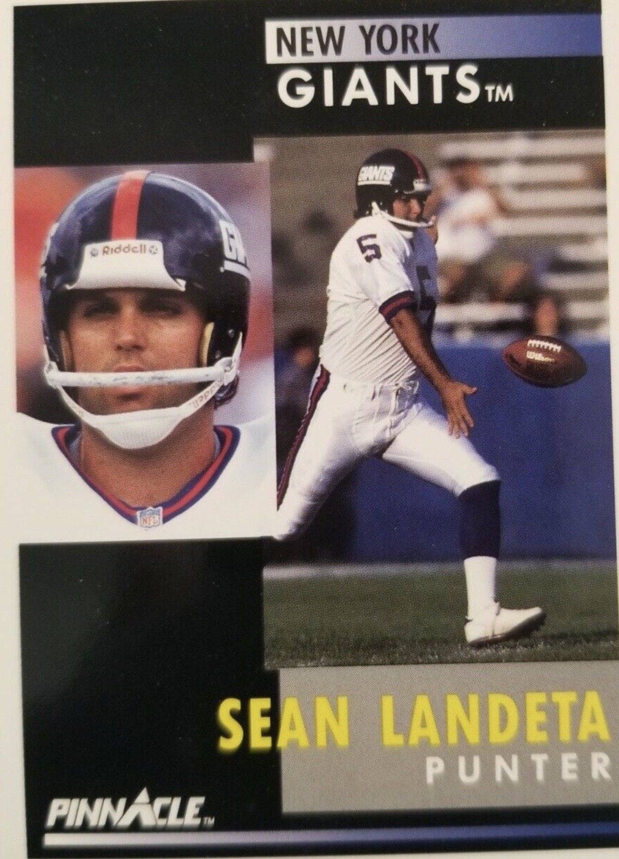
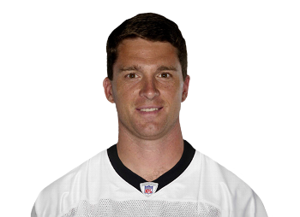
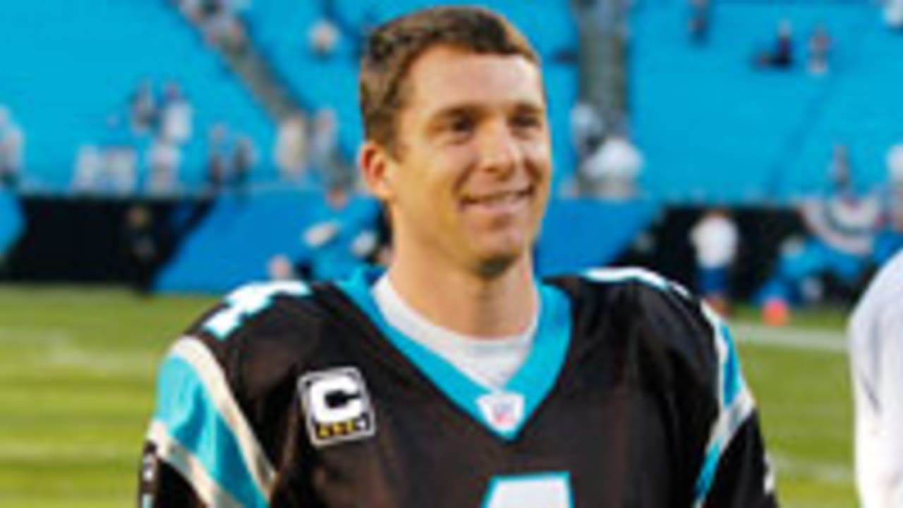
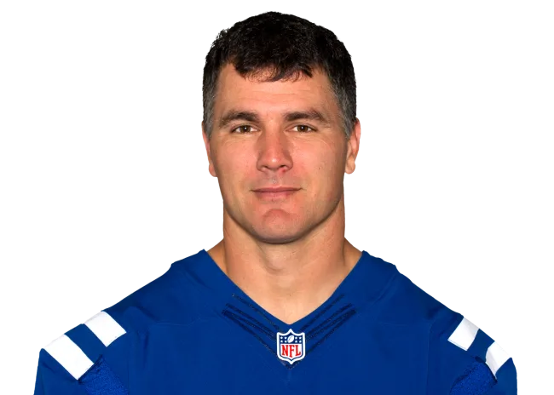
Morten Anderson Gary Anderson John Carney
Placekicker
Placekicker
Placekicker
1982-2007 1982-2004 1988-2010
Adam Vinatieri Sean Landeta John Kasay Jeff Feagles
1996-2019 1983-2006 1988-2010 1988-2009
Placekicker
Punter
Placekicker
Punter
Notes:
Diego
https://www.nfl.com/players/
Adam Vinatieri (Actually 24 years)

Slide 9
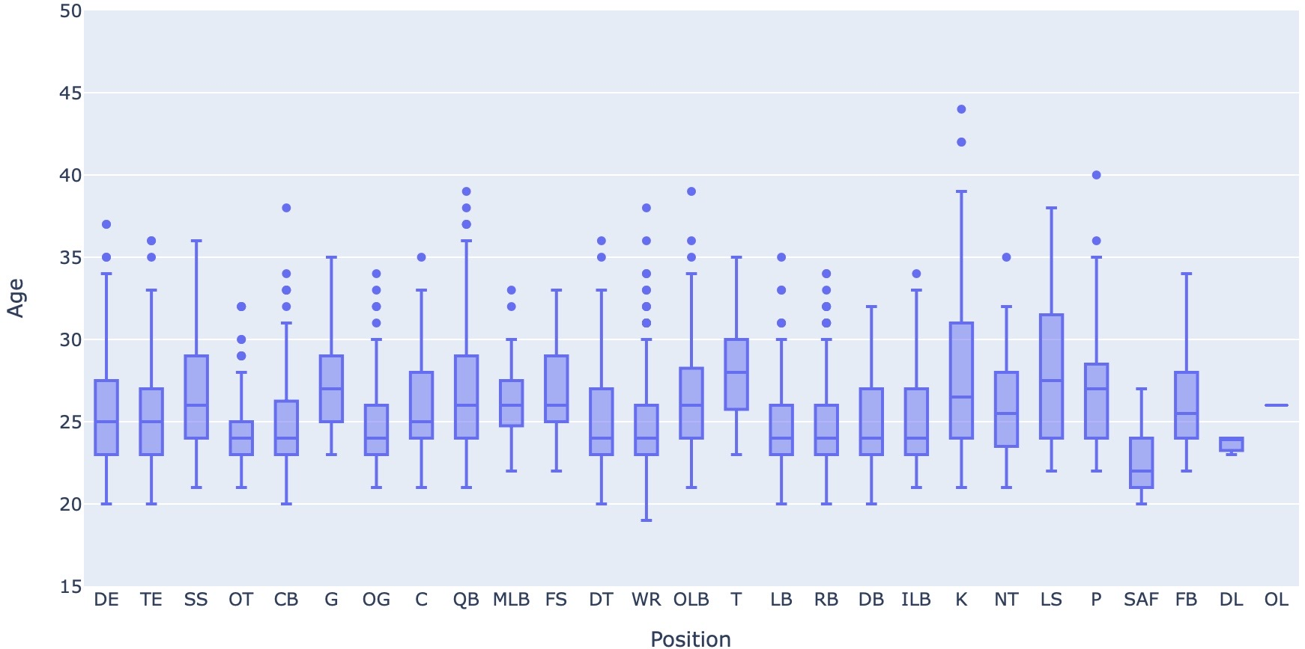
Current NFL Position vs Age
Oldest active players:
Kicker
Punter
Quarter back
Notes:
Age vs positions
Longest careers
K. Kicker
P Punter
QB Quarterback

Slide 10
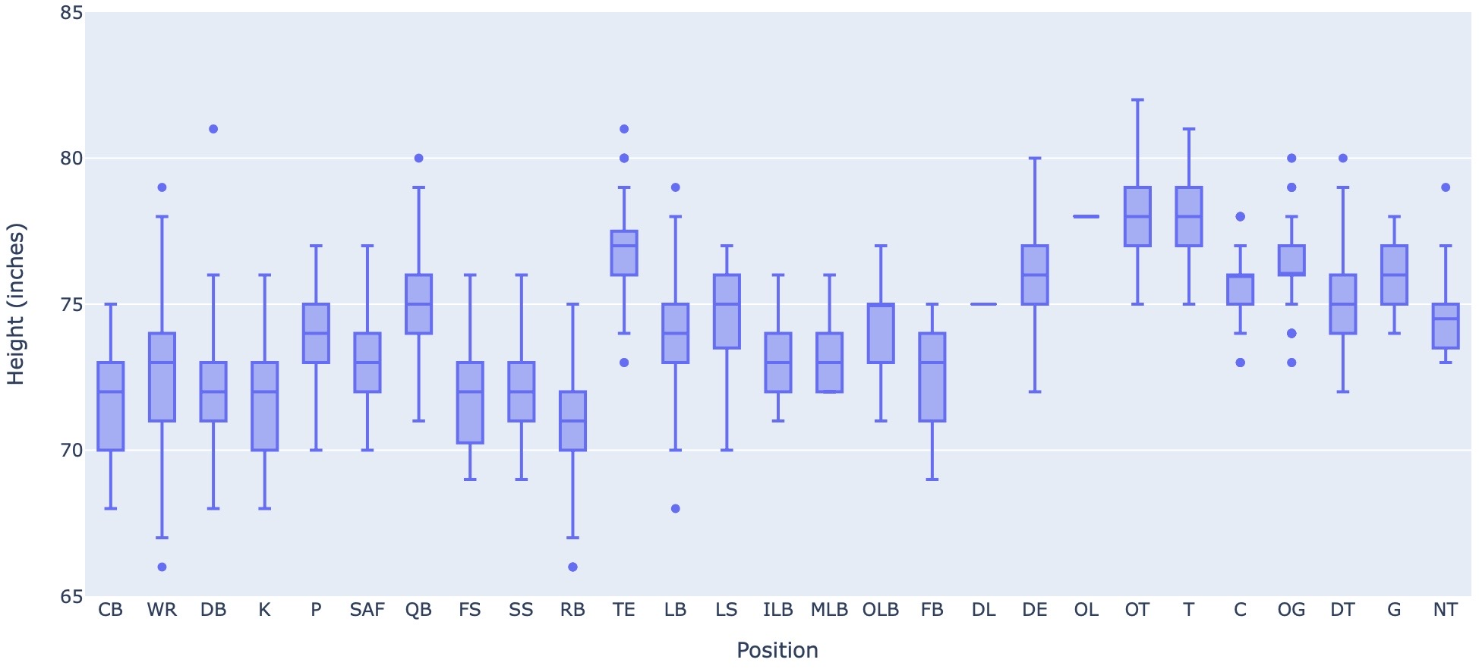
Current NFL Position vs Height
Tallest active players:
Offensive tackle
Tackle
Tight end
Notes:
Age vs positions
Tallest
OT
T
TE
Shortest
RB
CB
DB
K

Slide 11
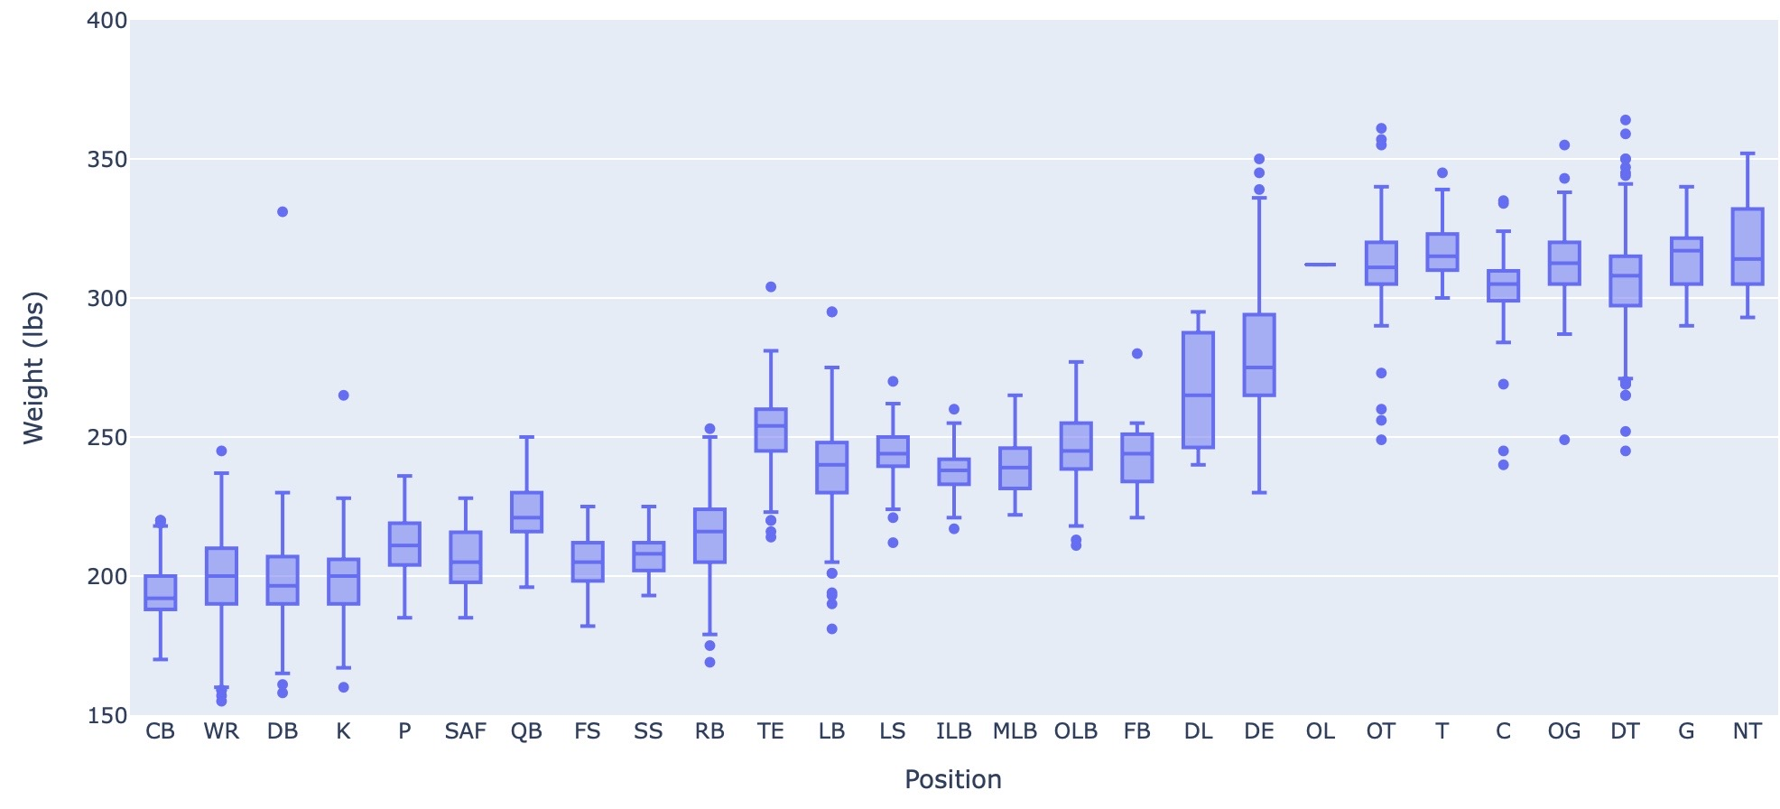
Current NFL players vs Weight
Heaviest active players:
Offensive tackle
Defensive tackle
Notes:
Age vs positions
CB Corner back
WR Wide receiver
DB Defensive Back
K Kicker
Run and catch
Average under 200lbs
OT Offensive Tackle
T. Tackle
C. Center
DT Defensive Tackle
G Guard
NT Nose Tackle
Over 200lbs

Slide 12
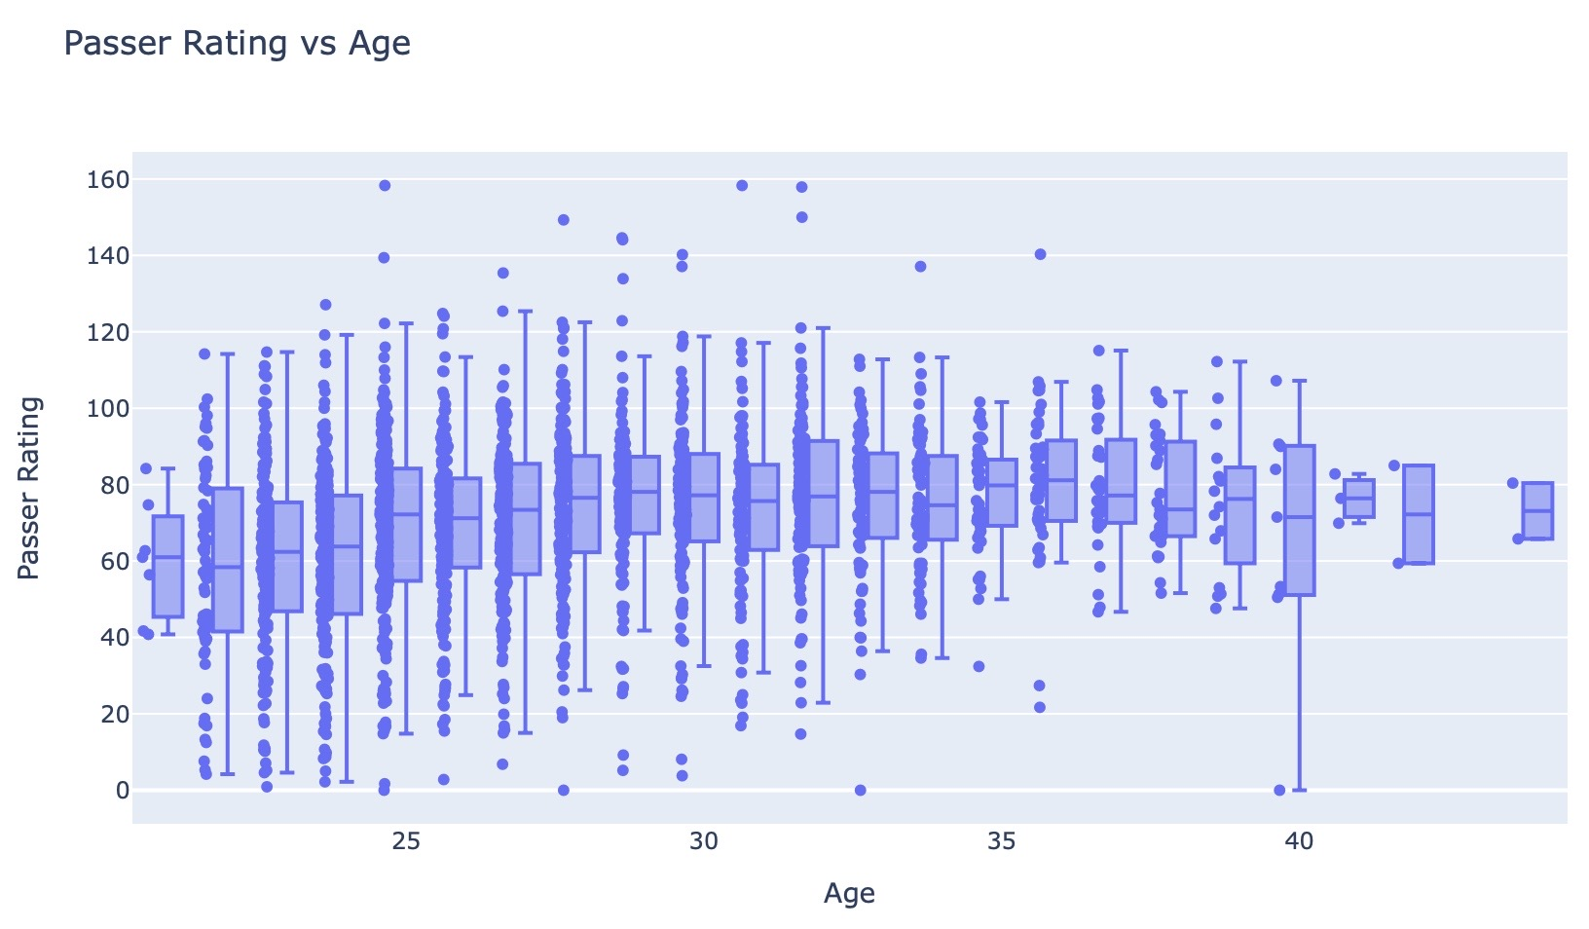
Notes:
Prabu
Talk about finding, retaining quarterbacks

Slide 13
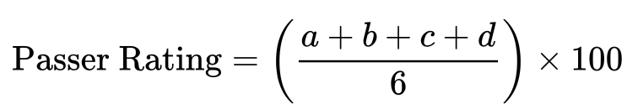
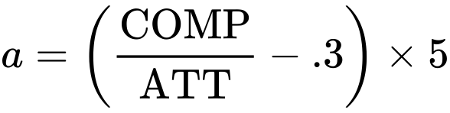
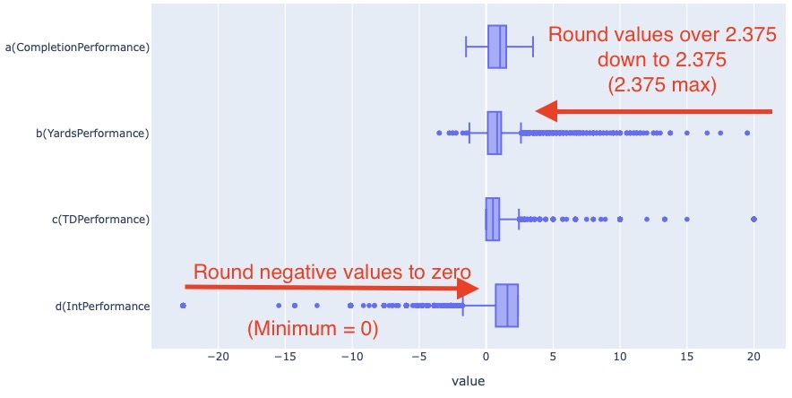
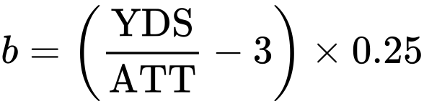
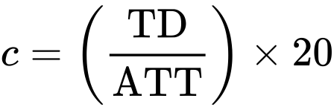
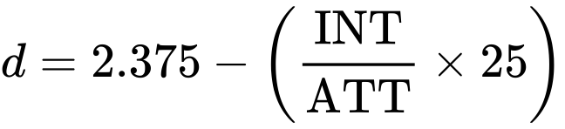
Notes:
Prabu
A, B, C, and D must be between 0 and 2.375
ATT = Number of passing attempts
COMP = Number of completions
YDS = Passing yards
TD = Touchdown passes
INT = Interceptions

Slide 14
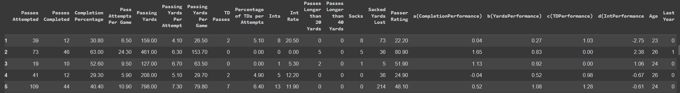
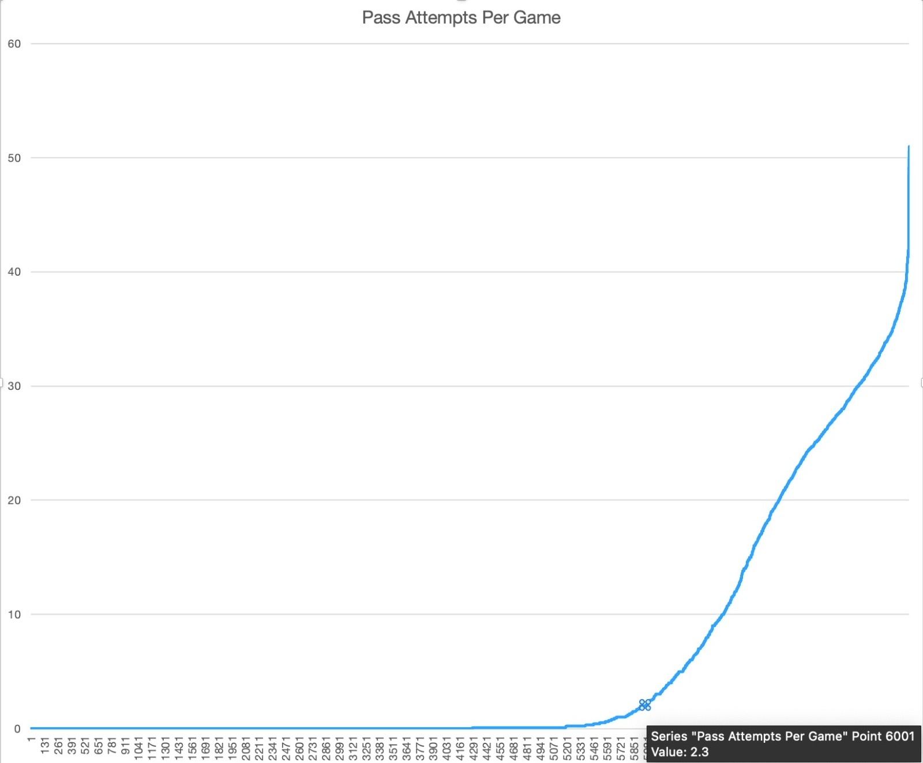
Machine Learning
Can we expect a certain player to retire the current year based on stats?
Data Janitoring
Merged basic data dframe (demographics) and passer statistics data frame
Any incorrect player data in 2017 was dropped from this data
Any player above age 50 was not considered as a part of the analysis
Data of passes attempted per game below a threshold value of '3' was insignificant. Refer graph on the right
Created new column indicating whether the player's last year was 0 or 1
Data for the classification tree
X = Passes Attemped, Passes Completed, Completion %, Pass Attempts per Game, Passing Yards, Ints.. etc
Y = Last year defined as truthy value
0 – not the last year for the player; 1 – It is the last year for the player (retire)
Notes:
dddd

Slide 15
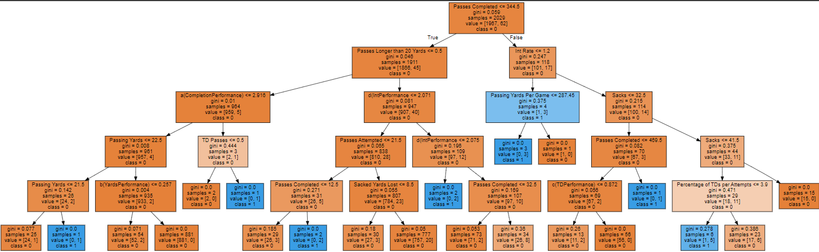
In this data for an active player, we found that the variables that correlated with whether he will retire or not were
Passes Completed
Intercept Rate
Sacks
Percentage of Touch Down's per attempt
Notes:
Aarthi

Slide 16
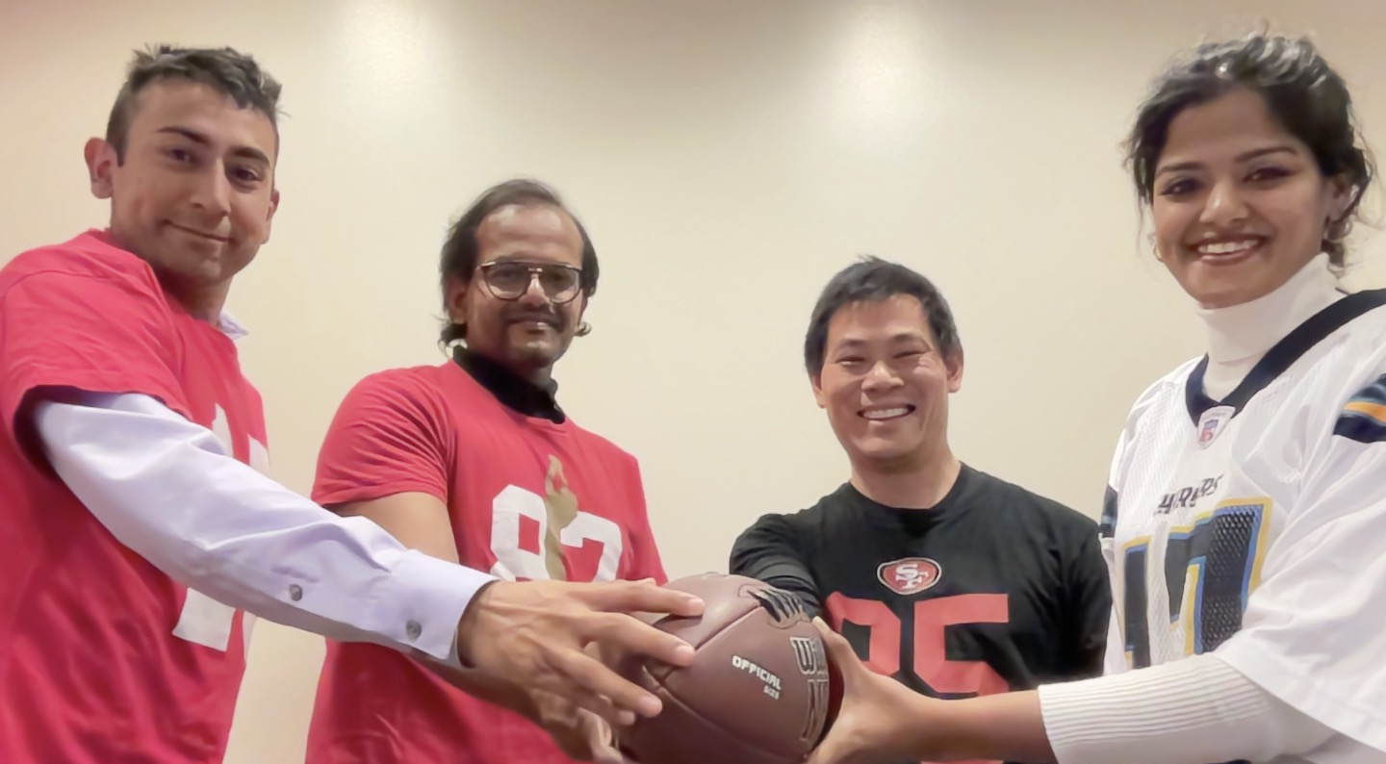
Thank you!

